Slide 1

Battle of Attrition and Salary
Dylan Scott
14/16/2021
Notes:
Thanks for meeting today
We will be discussing Attrition and salary, both very important and expensive topics for many top companies
Let’s get into it

Slide 2
Agenda
What are the top factors that lead to attrition?
Can we predict employee turnover and how well?
What factors impact employees pay?
Can we predict monthly income and how well?
Notes:
Ultimately, we’d like to answer these 4 questions
Top factors that lead to attrition and can we predict turnover or possibly lessen that strain on the company if we see those predictors
We’d also like to looks at salary which many see as the only factor in attrition but as we will see it is not the only factory
Lastly, can we anticipate someone's monthly salary and which metrics are important in that prediction?

Slide 3

Data Overview
19 Continuous variables
17 Categorical variables
8 Ordinal
9 Nominal
0 Missing values with
36 Total variables
870 Observations
Notes:
In our data we saw 36 total variables with 870 observations
We had no missing values which is great
Of those 36 variables we had 19 continuous variables
And 17 categorical variables
Which we further broke into 8 ordinal and 9 nominal variables

Slide 4
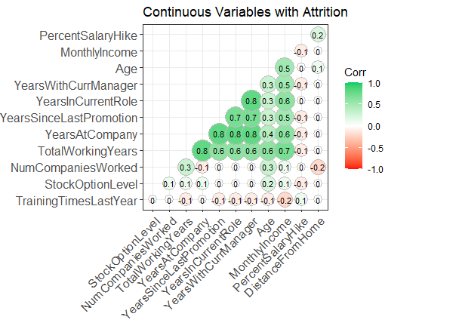
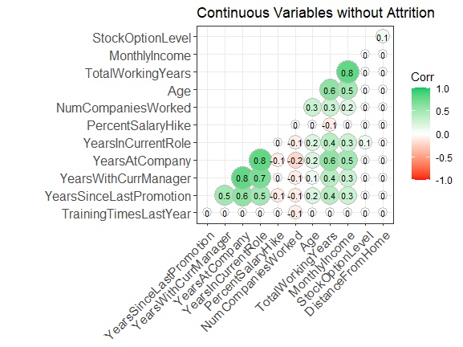
Heatmap Correlations
Notes:
First off we looked at the corrlelations as it protains to the 19 continuous varbles
Overall we do see a shift as it pertains to attrition most notable in any field that relates to years such as years with the coampny

Slide 5
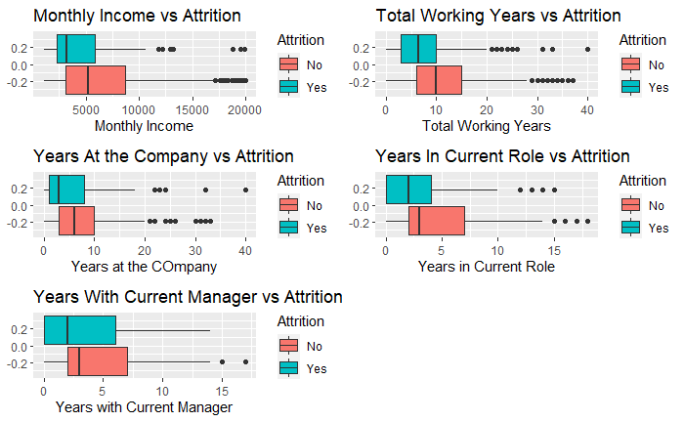
Attrition vs. Continuous Variables
Box plots were used to determine a difference in outcome.
Two sample T-Tests were used to determine a difference in means.
We want to avoid variables that explain the same thing.
Variable | T.Test.pvalue
MonthlyIncome | 2.412488e-07
TotalWorkingYears | 6.595682e-07
YearsInCurrentRole | 1.522152e-06
YearsWithCurrManager | 5.084229e-06
YearsAtCompany | 2.563021e-04
Notes:
Diving into the continuous varabels a little more we saw 5 of the box plots that would indicate a different outcome of attrition
Running a 2 sample T test we see that all 5 of these varables are significan
One thing we would like to avoid however are varables that explain the same thing
This is called colineararity and we see a bit of a trend here with the years varables
Soemone with many working years is likely to have high years at a company and high years with their manager
Moving forward we are going to use monthly income and total working years in our model
However, something we want to avoid in a predictive model is colineararity where varables look related to eachother as well as the outcome static
Among these varalbes we determined that many of them had some collinearity for example someone who has worked many years is likely to have a high years at the company, years with current manager and years in current role
For this reason we won’t be using all these varables in our model later on

Slide 6
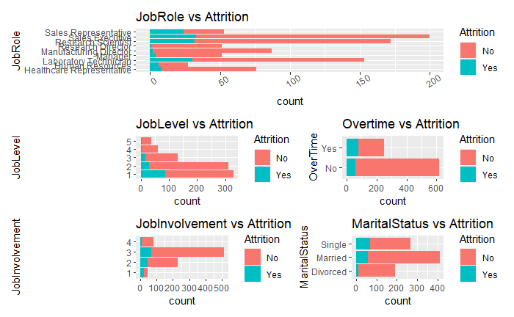
Categorical Variables
Bar charts were used to show the count of employees who left in that category.
Once again, we have out top 5 P-value .
Variable | Chisq.pvalue
JobLevel | 2.332981e-15
OverTime | 6.595682e-07
JobInvolvement | 5.211041e-09
JobRole | 3.646836e-10
MaritalStatus | 3.378946e-08
Notes:
Here we used the P value achieved from our chi square test to determine significance
Once again we have 5 categorical varalbes that show signifacne
One thing to note is marital status marred status showed an extremely high attrition rate and this may be due to benefits and less of a lack of income reliance
Something to note though is during the interview process it is illegal to ask about marital status when interviewing someone
Because of this the I highly recommend not looking at this stat as a prodicotr because the static itself is tough to achieve and illegal in most cases

Slide 7
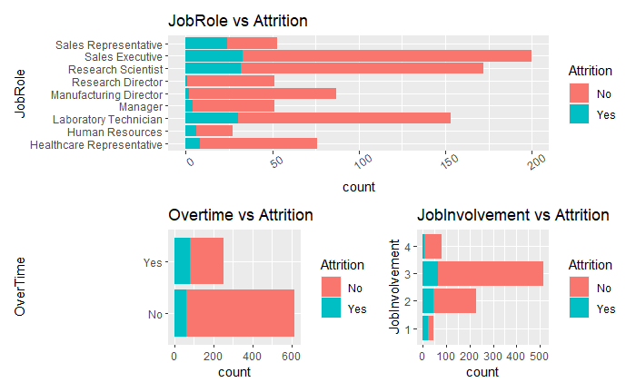
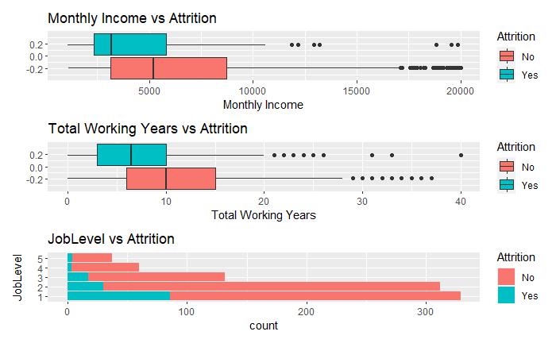
Variables used to Predict Attrition
Accuracy : 89%
Sensitivity : 93%
Specificity : 62%
Notes:
Given all the significan varbles both categorical and continuous our model used these
Jobrole
Overtime
Job involvement
Monthly income
Total working years
And job level
Overall we could predict the right outcome of attrition with 89% accuracy
93% sensitivy and
62% specificity

Slide 8
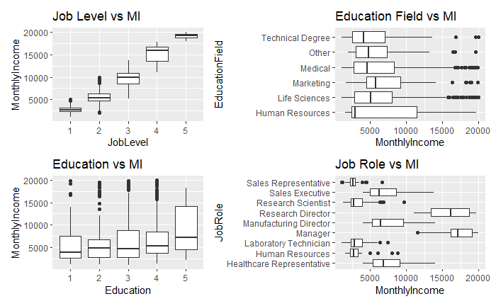
Salary – Categorical Variable's
We looked at 4 variables
Job level shows a strong linear pattern
Notes:
Now that we’ve looked at attrition we next wanted to look monthly income
Looking at the caegogrical varables we see one boxplot sitcks out and that is job level
This has a strong positive correltion to monthly income and this is expected
As someone moves up in job level they can expect a large pay raise

Slide 9
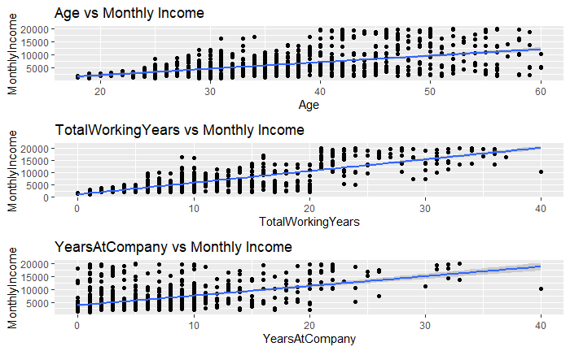
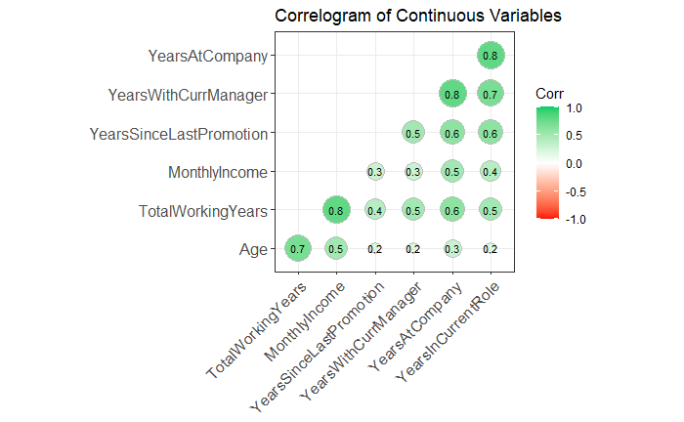
Salary – Continuous variables
The larger the dot the more correlation between the variables
Age and total years work my have some dependence
Years at the company shows a different story from age and working years
Notes:
Staying at a company longer isn’t very well rewarded

Slide 10
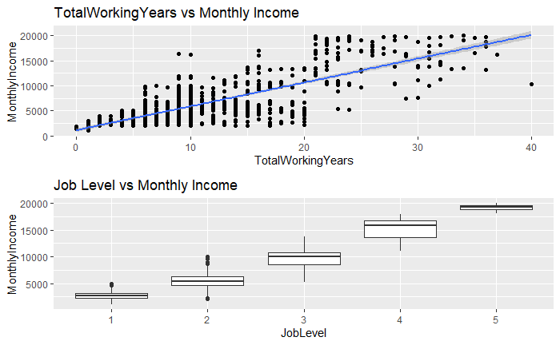
Salary Prediction
Two variables selected
R² : .92
RMSE $1261

Slide 11
Thank You
Github https://github.com/scottdyl/CaseStudy2DDS
Email Drscott@smu.edu

